Slide 1
KIND – Mu Sigma
Estimated Effort Plan for Q2 2021

Slide 2
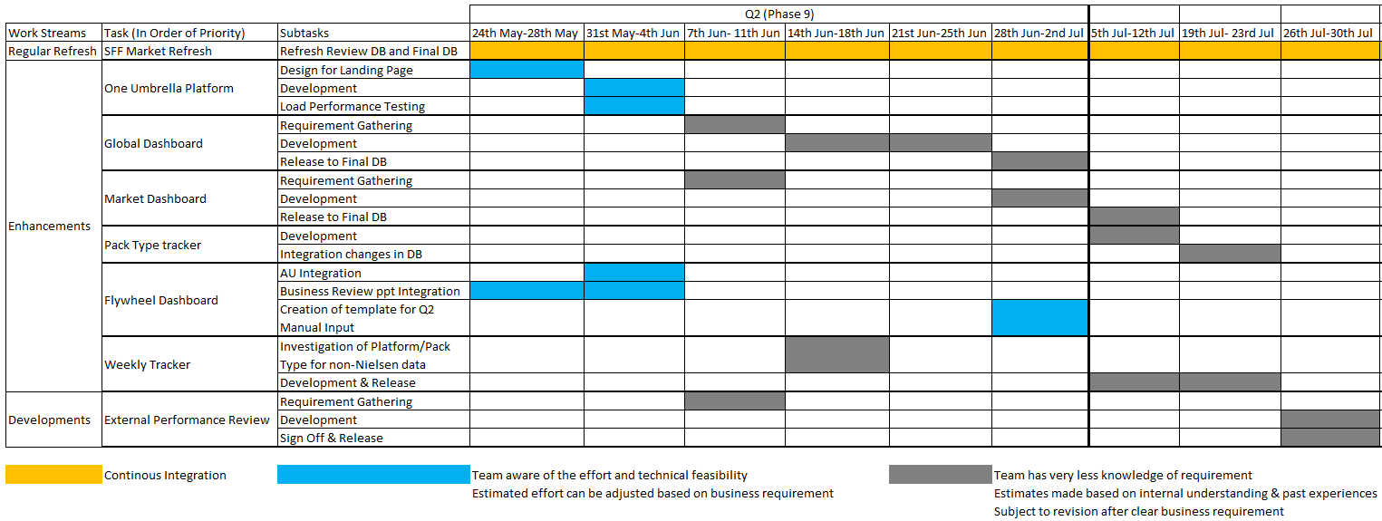
Detailed Q2 Plan- Estimated Effort
Refer attached excel for more details ---->
**One resource will be dedicated for Regular refresh with some overlap on other workstreams
**Ideal utilization >=100% when team works on 3 work streams parallelly in a week
**All the estimated effort includes adequate buffer time although the actual effort could differ after the full understanding of the business requirement

Slide 3
Planned Outcomes for the Quarter Phase 9
Regular Refreshes:
Update the dashboards with latest periodic data
One Umbrella:
Go live with the One Stop Landing page for all the dashboards and Tracker
Flywheel:
Integrate AU
Include the Business review ppts
Prep for Q2 manual templates
Enhancements:
Complete business requirement gathering for all the enhancements
Deliver enhancements for Global dashboard
Start the development for Market/ Pack Type Tracker enhancements once Global dashboard is released
Weekly Tracker:
Complete investigation of the Platform and Pack type level information
Development External performance:
Understand the complete business requirement and identify if there is overlap with enhancements in Global and Market dashboard
Update the dashboards with latest periodic data

Slide 4
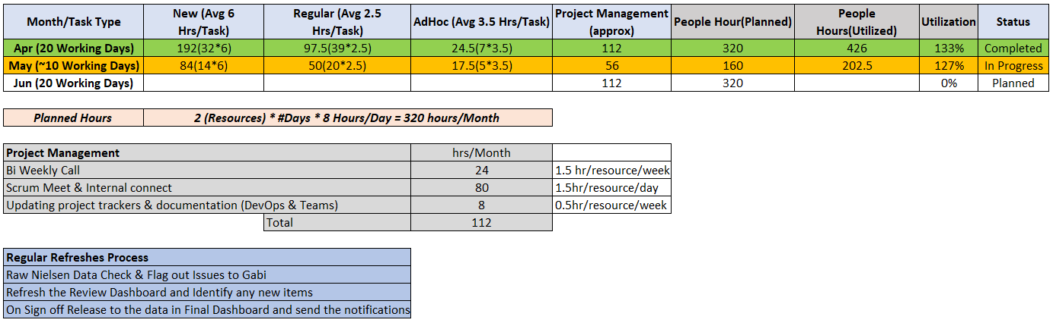
Current Utilization of the Team for Q2

Slide 5
Appendix
Business Requirement

Slide 6
Q2 2021 Planning
 | Q2 2021
Regular | SFF updates: 12 countries UK, FR, DE, RU, UAE, KSA, AU, IT, SE, NL, PL, CH (one update)
Enhancements | 1. One Umbrella Platform: integration of all dashboards & trackers under one platform -> loading time investigation 2. Global & Market Dashboard revision: keep vs. remove (Gabi) adjust existing vs. new analysis 3. FW Dashboard: AU integration New features & adjustments (TBD) Ice Cream NA – investigate 4. Weekly Tracker: Pack type / Platform
Developments | External Performance Periodical Review (replicate existing ppt deck / pre defined format)

Slide 7
Q2 2021 Planning
Enhancement details Global/Market Dashboards
 | Q2 2021
Enhancements | Global & Market Dashboard revision: Global Category Segment share report & pack type split KIND output: Units & Units share reporting KIND driver: CWDP / Unit SPDP Key Competitors reporting (as per above for KIND) Channel: integrate SPDP SPDP – integrate development similar to CWDP Market KIND Platform & Pack Type reporting Output RSV/Share Drivers: CWDP / ROS / SPDP Integration of Consumer: ABA/UBA (etc) Pack Type share report Extend to Platform

